Slide 1

IS597 – Programming & Quality in Analytics
The Influence of Imports and Exports of a country on the GDP
Group members: Aayusha Sheregar, Nuka Rishitha
DEPARTMENT / UNIT NAME
GRAINGER ENGINEERING

Slide 2
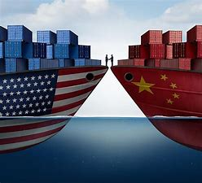
Introduction
Purpose of the project
The purpose of this project is to expand on the findings of the article – “List of Top 10 Export and Import Source of India ” – by Jagran Josh .
We also aim to explore imports and exports of a country to analyze if it has any direct relation with the GDP.
Furthermore, this project also addresses the effect of global slowdown on GDP during the period 2014-16.
GRAINGER ENGINEERING

Slide 3
Introduction
What is import?
Imports are foreign goods and services bought by citizens, businesses, and the government of another country.
What is export?
Goods and services that are produced in one country and sold to buyers in another
What is GDP?
Monetary measure of the market value of all the final goods and services produced in a specific time period by countries.
How important are imports and Exports?
Countries vary considerably regarding how important imports and exports, and their overall balance of trade is to their economies. The growth of economies of developing countries is often fueled by massive exports of commodities and raw materials to developed nations
GRAINGER ENGINEERING

Slide 4
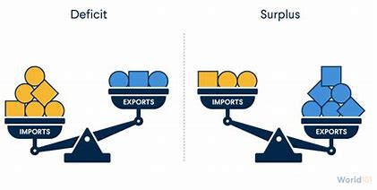
Data used – Jagran Josh Article, Import and Export data of India with the world, GDP of all the countries in the world, Trade balance of all the countries in the world
Three hypothesis and their conclusions
.
Project Description
Trade surplus | Trade deficit | Trade Balance
the value of a country's exports exceeds the cost of its imports | the value of a country’s imports exceeds the cost of its exports | Difference between the value of a country’s imports and exports over a given time period

Slide 5
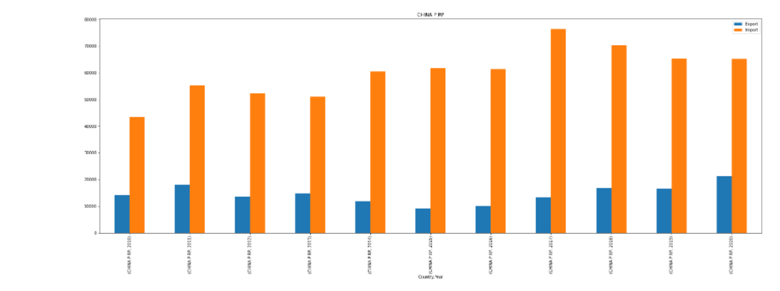
Hypothesis
Hypothesis -1
As per the article India is in trade deficit with China for the last 10 years. However, we believe this statement is not true as India ranks 5th in the world economy and China is one of its largest destinations for exports
GRAINGER ENGINEERING

Slide 6
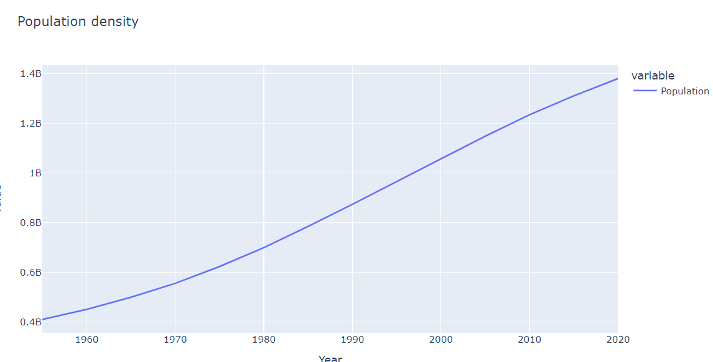
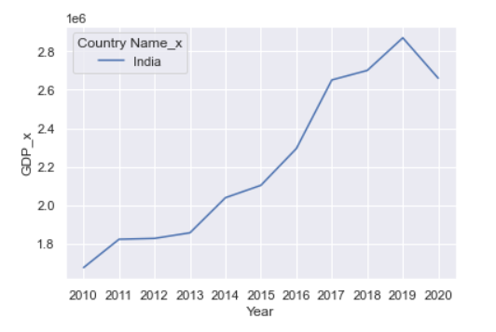
Hypothesis
Conclusion
By analyzing the graphs provided, we reject our hypothesis, and it is concluded that India is in trade deficit with China
India’s trade deficit with China has visibly no effect on India’s GDP
Other factors that could have affected India’s GDP – Employment rate, Population density, Political and social factors
GRAINGER ENGINEERING

Slide 7
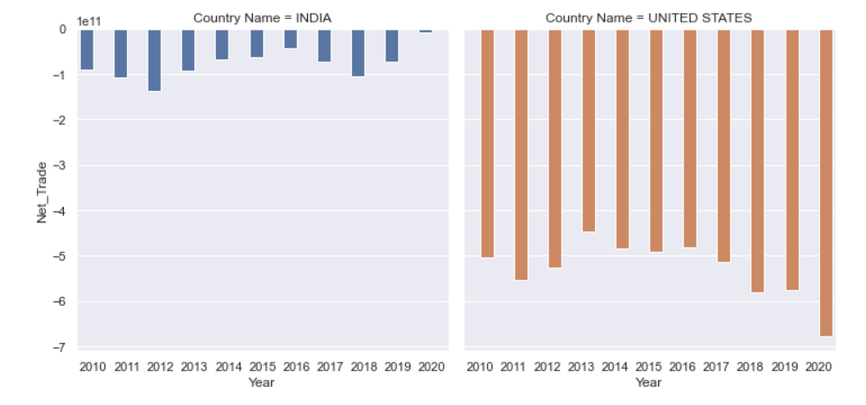
Hypothesis
Hypothesis -2
Do ALL countries with a trade deficit for past 10 years in a row have a direct effect on their GDP?
After analyzing the data and performing the necessary functions, we found that India saw an increase in its net trade from 2019-2020 and the United States has been in a trade deficit for the past 10 years in a row.
GRAINGER ENGINEERING

Slide 8
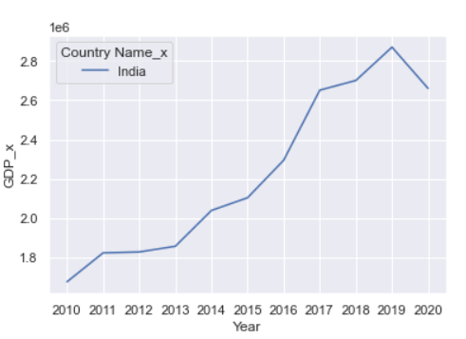
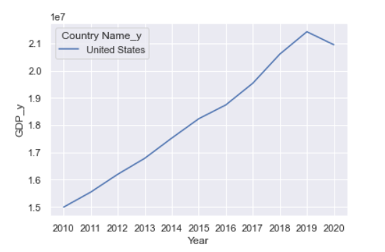
Hypothesis
Conclusion
Even though the net trade increased, the Indian GDP decreased from 2019-2020.
There is a uniform trade deficit experienced by United States, but at the same time there is a steady increase in the country’s GDP as proven in the graphs.
Hence, we conclude a country’s net trade has no direct relation with its GDP.
GRAINGER ENGINEERING

Slide 9
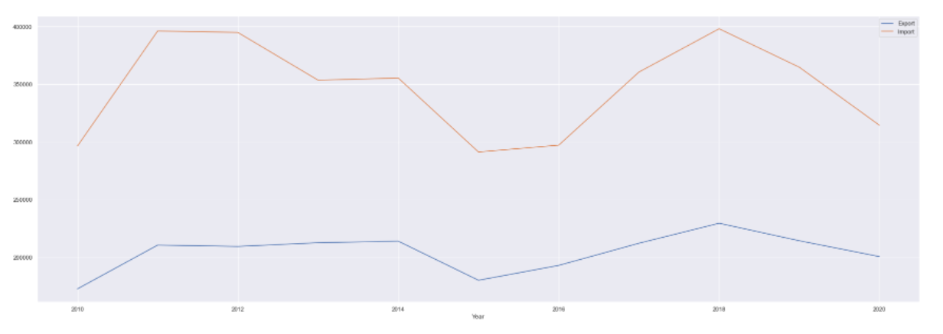
Hypothesis
Hypothesis -3
Did the global demand slow down and fall in crude oil prices during the period 2014-16 affect India’s exports of mineral fuel?
GRAINGER ENGINEERING

Slide 10
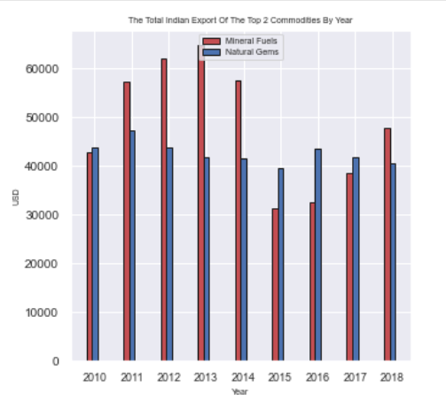
Hypothesis
Conclusion
As shown in the chart below, we can see that there was a significant dip in the exports of Mineral Fuels by India. Hence, we have proven with the help of visualizations that the global demand slowdown has had a negative effect on the exports.
GRAINGER ENGINEERING

Slide 11

Conclusion
After extensive research, we found:
There are several factors that could affect imports and exports of a country like trade agreements, currency devaluation.
A country's importing and exporting activity can influence its GDP. But there is no direct relation between these factors.
Even though United States sees a steady increase in GDP, it has been experiencing trade deficit for a considerably long period of time. The same applies for India as well.
The most exported product by India is usually Mineral Fuels but this could change owing to the changes in the demand as well as crude oil prices.
GRAINGER ENGINEERING

Slide 12
IS597 – Programming & Quality in Analytics
THANK YOU
DEPARTMENT / UNIT NAME
GRAINGER ENGINEERING

